Slide 1

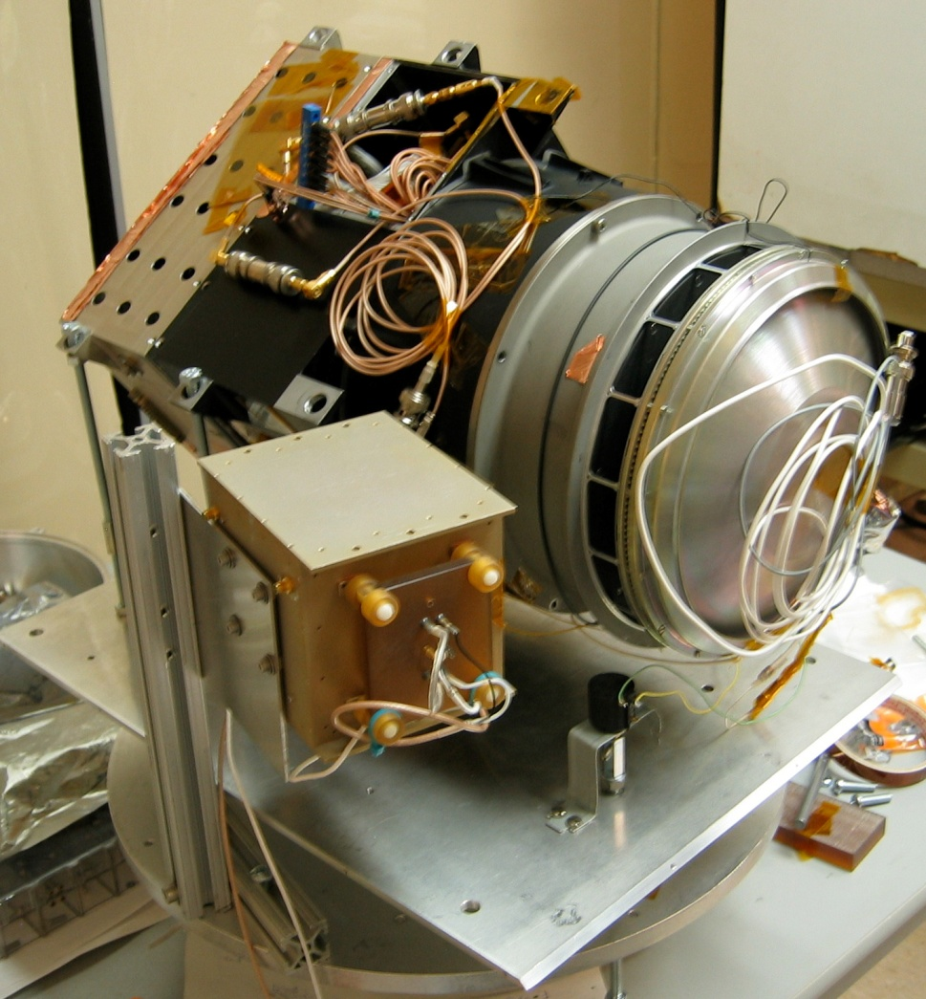
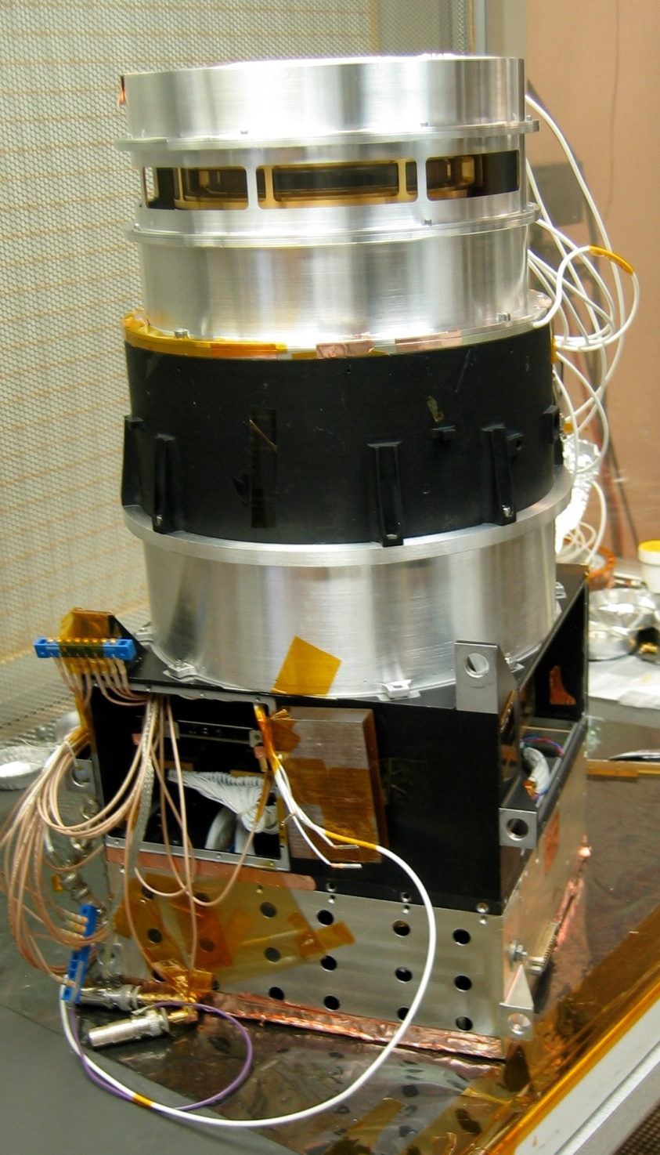
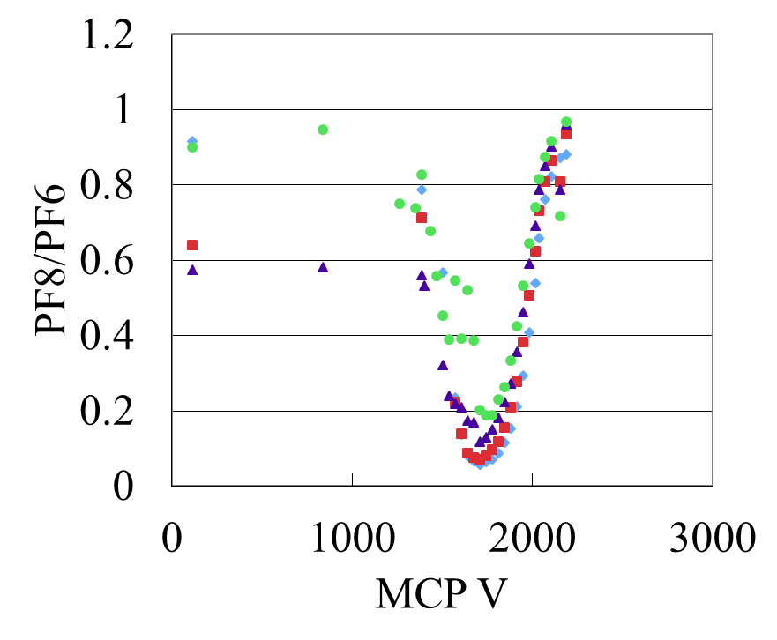
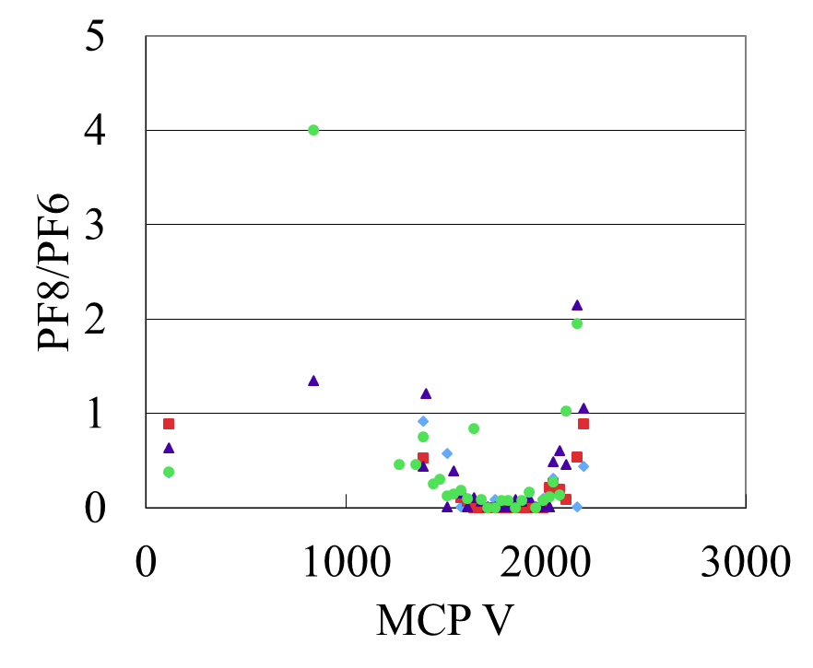
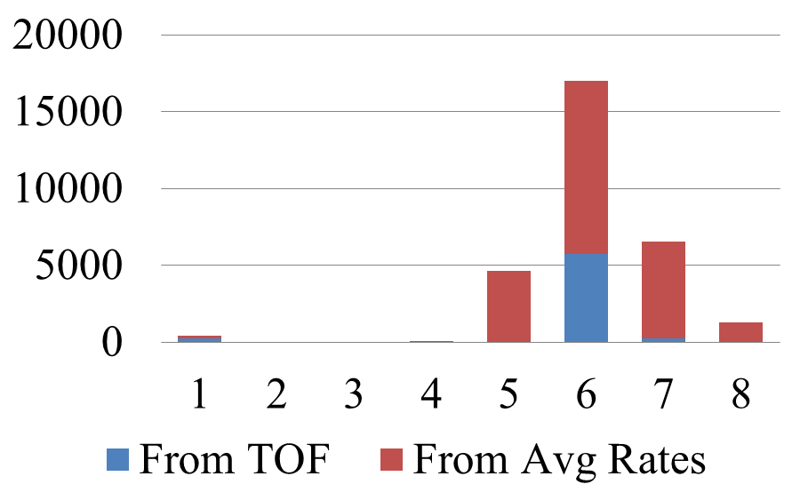
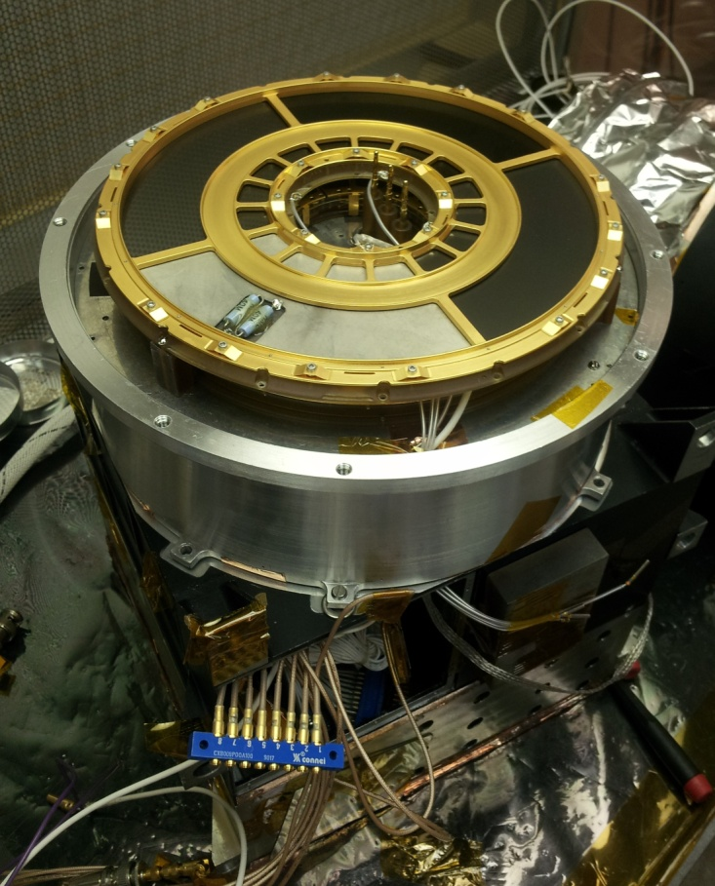
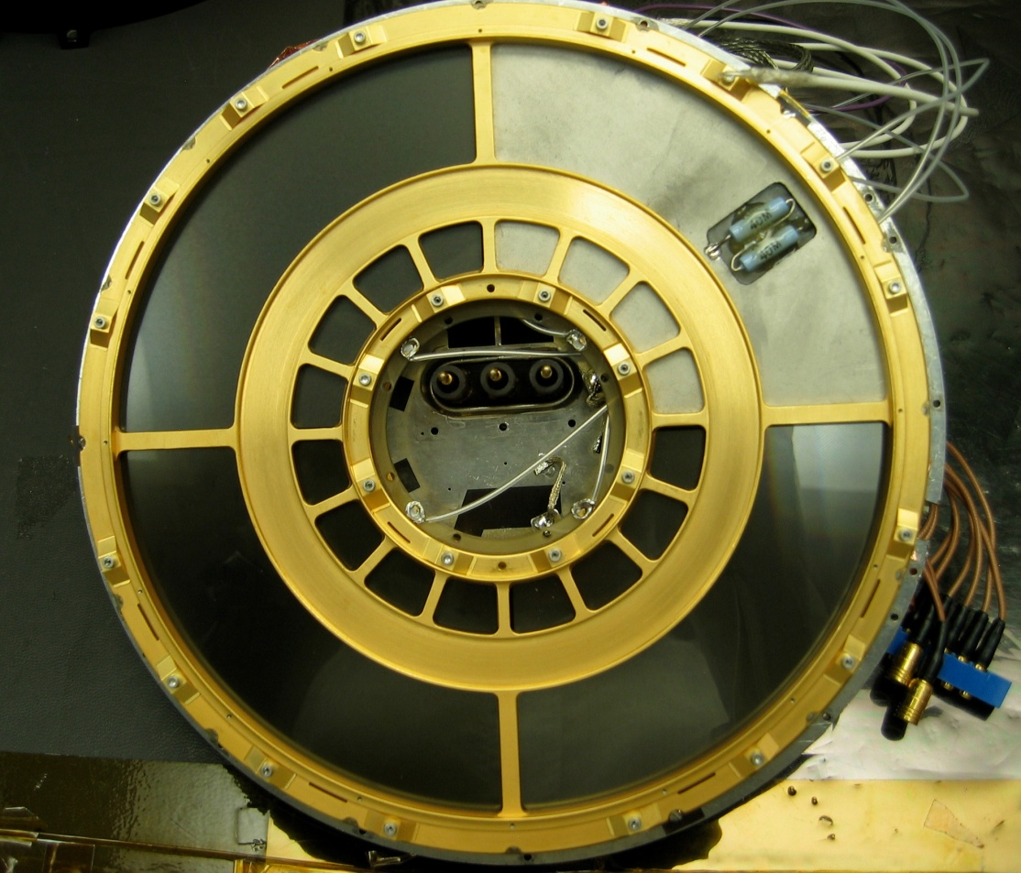
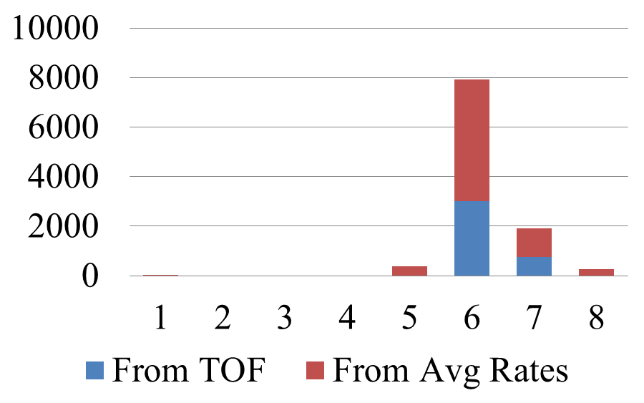
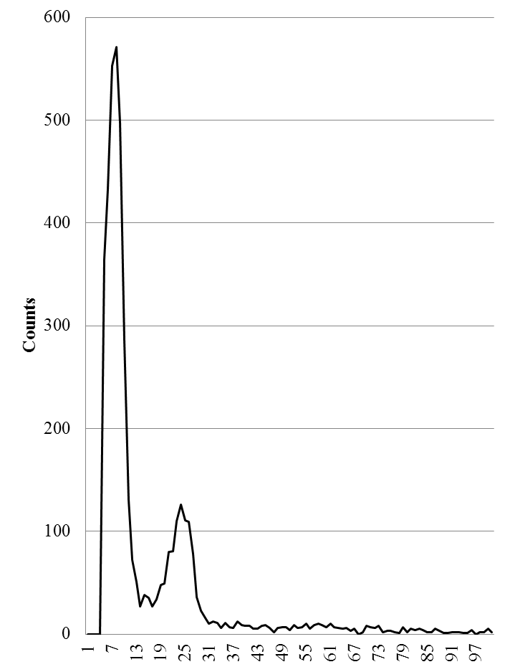
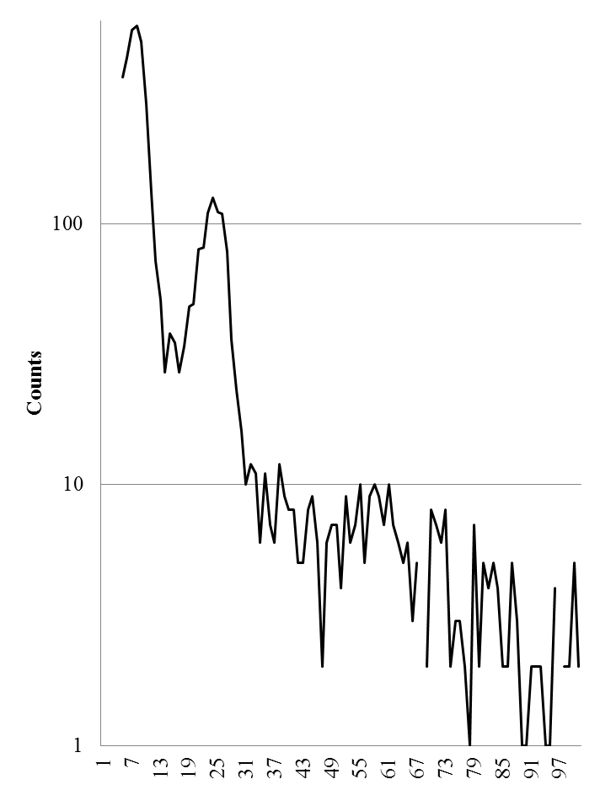
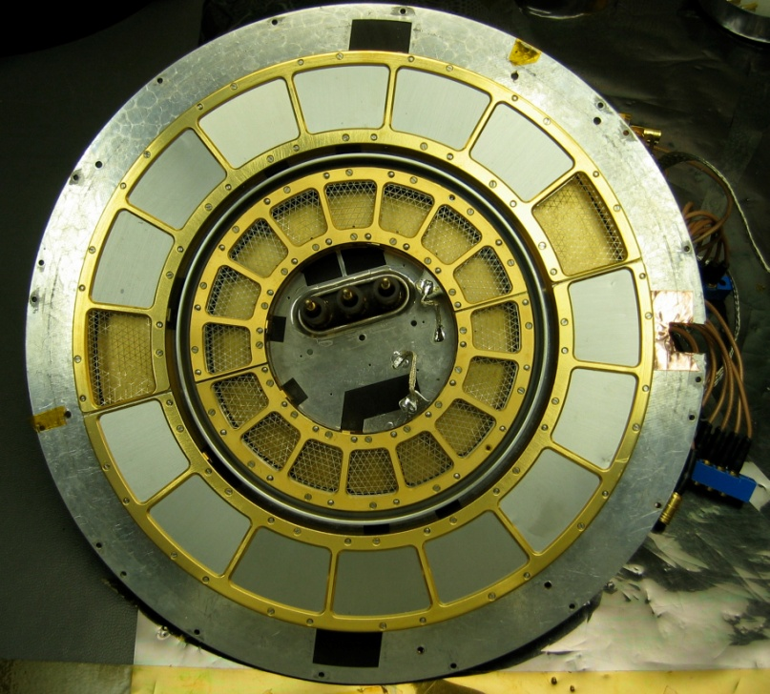
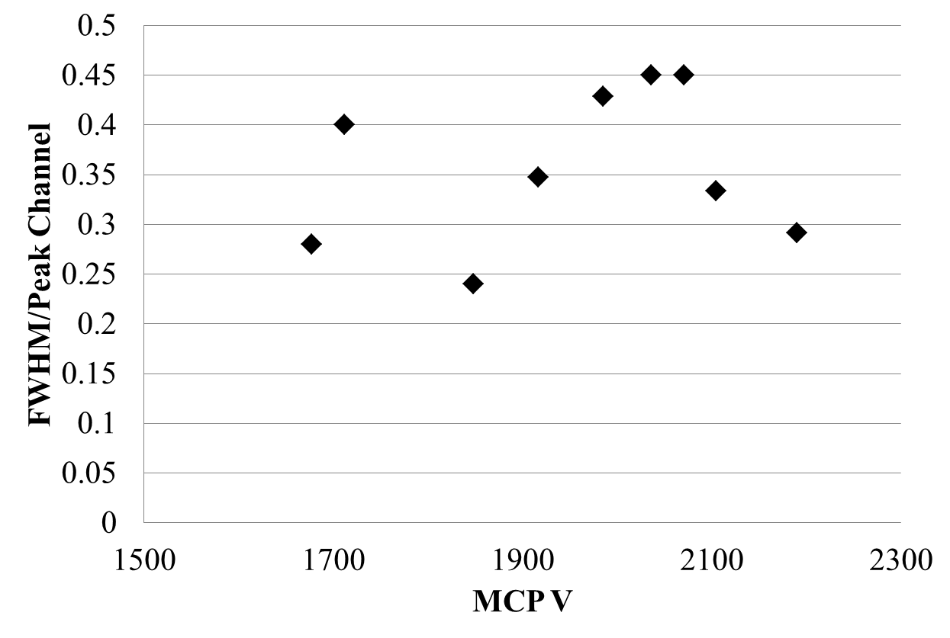
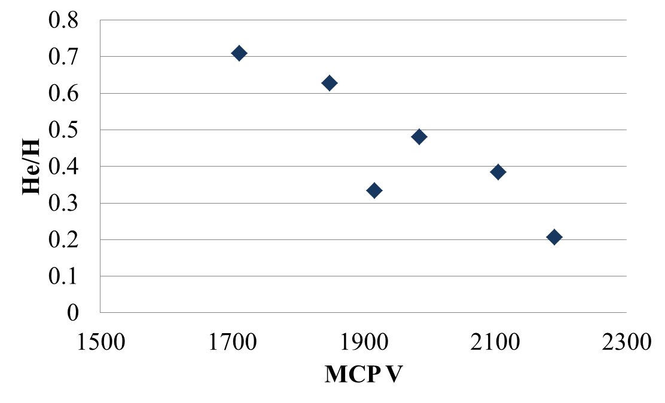
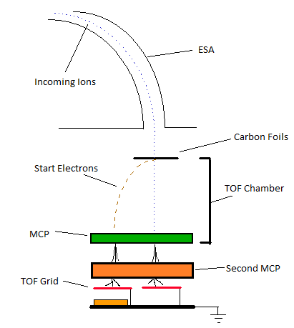
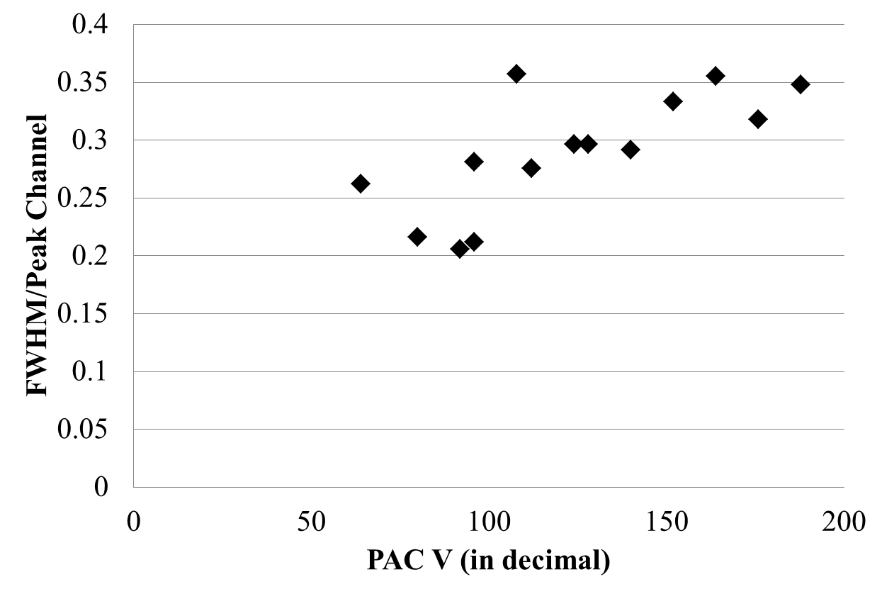
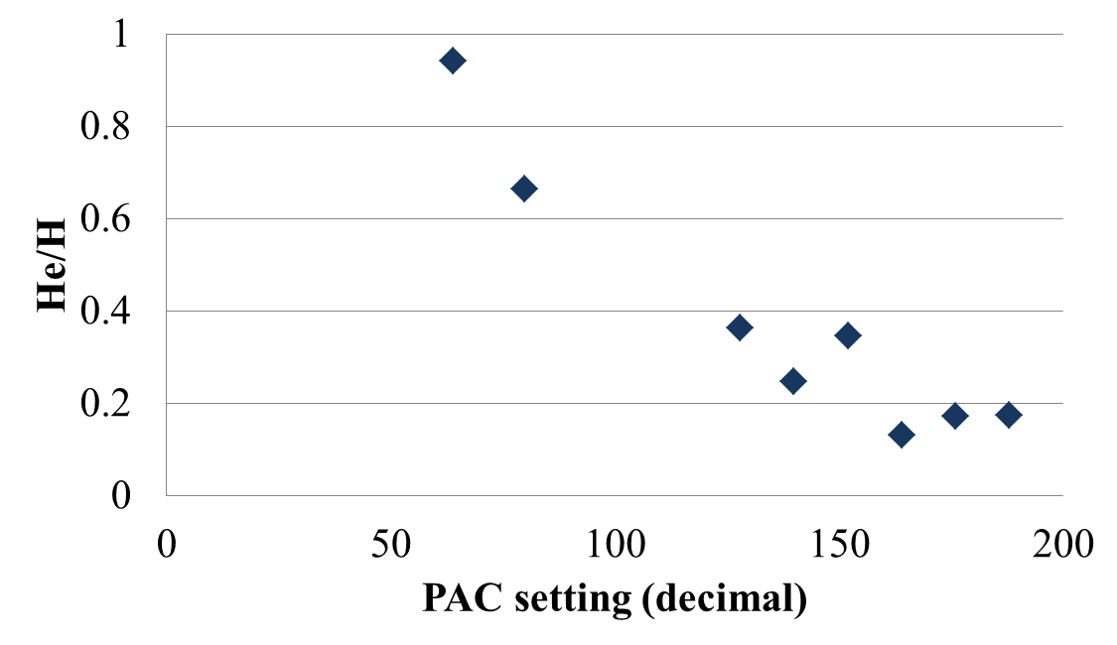
Improving Detection Efficiency of a Space-based Ion Mass Spectrum Analyzer
Anne Lamontagne, University of New Hampshire; Mark Popecki, UNH; Lynn Kistler, UNH
The Earth’s magnetosphere is the region surrounding the planet where the flow of particles is strongly influenced by the Earth’s magnetic field. The energy found in this region is provided by interactions of solar wind with the magnetic field. The magnetosphere may be studied by investigating electromagnetic (EM) waves, and electrons and ions. These particles can get their energy from the sun through the solar wind, and they may exchange energy with EM waves. The study of particles within the magnetosphere is done through mass spectrometry, examining either electrons or ions. Ions are particularly useful due to their variations in mass and charge. Their energy and motion are altered by interaction with electric and magnetic fields, and those interactions in turn depend on the mass and charge of the ion. It is possible to learn about ion sources as well, such as the Earth’s atmosphere or the solar wind. Currently, the CODIF Ion Spectrometer on the CLUSTER spacecraft is designed as a mass spectrometer for the magnetosphere. As a part of proposal efforts for future missions, work is being done to improve the detection efficiency of a CODIF-style instrument, renamed IMSA
Abstract
Results
The Instrument
  The results presented here are a performance evaluation of the instrument with the new second MCP deck. The data were obtained by varying the voltages applied to the top and bottom decks of MCPs, while at the same time keeping the gain in the top set low.
a)
b)
Left: Evaluating azimuthal crosstalk by taking the ratio of adjacent azimuth pixels, plotted for varying gains across the bottom MCP deck. The horizontal axis is the voltage of the top MCP deck.
taken from azimuthal counters.
taken from coincidence measurement, which requires TOF and only one azimuth measurement , as selected by the instrument logic.
B
A
Above, Right: CODIF before and after modification. Above shows CODIF mounted on turntable used for elevation angle tests. Right shows CODIF with new flux reducer entrance system and addition of second MCP deck (silver cylindrical piece)
c)
MCP V at A
Left: Selected measurements of time and position for individual ions are sent to the ground. These provide good azimuthal information, because only those events with single azimuth pixel measurements are sent. However, these data may be limited by available telemetry and processing time. Azimuth counters on the other hand provide a rapid, compact indication of ion direction. It is desirable for the azimuth counters to mimic the selective time/azimuth combined measurements (plot d) instead of spreading due to multiple, simultaneous triggers from large MCP pulses (plot c). The multiple azimuth measurement is a strong function of top deck MCP voltage above 2000 volts, for any bottom deck voltage.
CODIF can distinguish between H+, He++, He+ and O+ ions and measures their mass per charge ratio and the direction from which the ions entered the instrument. It views 360° of azimuth in 22.5° segments. In each 180° half, the azimuthal segments are known as PF1-8. Ions entering the instrument are selected by their energy/charge ratio, then fall through a high voltage, called the PAC. After that, they enter a detector section through a thin carbon foil window. The speed of the ion is measured in the detector section by timing the ion flight across a known distance. The timing is started when the ion creates a secondary electron as it exits the carbon foil. The electron is steered to a microchannel plate (MCP), which acts as a charge multiplier, producing approximately 1 million electrons for every input particle. The ion itself hits an MCP, ending the timing measurement. The energy/charge selection is combined with the speed measurement to derive mass/charge.
Principles of Operation
d)
MCP V at B
Below: TOF plots showing peaks for the ions H+, He+ and H₂O + at the following settings: PAC 20 kV, top MCP deck 1.9 kV gain and bottom MCP deck
2.5 kV gain, on a linear scale (e) and a log scale (f). The horizontal axis is flight time, which maps to mass/charge.
Above, Left: Two views of second MCP deck modification. Above is a side view of CODIf without the entrance system. Left is a top-down view of the MCP deck
e)
H+
f)
H+
He+
Below: TOF resolution of He+ versus MCP (plot g) and PAC (plot h) voltages. Peak resolution is given as the full width half-maximum (FWHM) of the peak divided by the peak channel number. PAC scale is given in decimal values, which is the logic that the instrument uses. PAC 188 is 20 kV.
Left: Signal board used to detect the ions and electrons. This is placed underneath the second MCP deck.
H₂O+
Modifications and Testing
g)
He+
H₂O+
The following changes were made to the instrument:
Flux reducer on entrance system, provided by Lockheed Martin in Palo Alto, to manage regions of high and low intensity ion fluxes. Tested:
    response to the incident ion elevation angle
    Reduction of the incident ion flux
Addition of second MCP deck:
  most e- multiplication now occurs near ground
  designed to reduce azimuthal crosstalk
  allow for higher overall MCP gain and therefore better detection of ions.
Conclusions and Future Work
i)
Azimuthal uncertainty versus top deck MCP voltage
  The azimuth taken from the azimuthal counters and TOF data are stable for a wide range of top deck MCP voltages
  However, the uncertainty in the azimuth from the PF rates is a steeper function of the bottom deck MCP voltage
Implementing second MCP deck addition
  Assembled MCPs for the second deck
  Built structures to support and house the new configuration with second
  MCP deck
  Extended cables and
  attached HV leads
Right: Ratios of counts in the region of interest of Helium to Hydrogen versus MCP (plot i) and
PAC (plot j) voltages.
Time of flight resolution versus MCP and PAC voltage
  As the MCP and PAC voltages decrease, the TOF resolution of the ions decreases as well
  The effect from the PAC voltages decrease is that the ions have less energy to begin with, and then lose more energy while traveling through the carbon foils
  The ratio of He+ to H+ increases as MCP voltage decreases. This indicates we see less H+ as the MCP voltage drops.
h)
j)
Right: Modified IMSA configuration. The recently added MCP deck is shown in orange
The next step in testing this instrument is to compare these results to the current version of CODIF to asses the value of the second MCP to the overall performance of the instrument.

